Slide 1
SHELL
A Shell is a computer program that interface between user and Unix like operating System
The command you type in command line is understood and interpreted by program and gives the desired output after execution of your command.
The program that understand your command is called Shell.
Types of shells
Ash shell
Bash shell
Korn shell
T-shell
C-shell
Z-shell

Slide 2
Common features of Shell
Command | Meaning
> | Redirect output
>> | Append to file
< | Redirect input
<< | “here” document (redirect input)
| | Pipe output
& | Run process in background
; | Separate commands on same line
* | Match any character(s) in filename
? | Match single character in filename
[] | Match any characters enclosed
() | Execute the subshell
$var | Use the value of variable
$$ | Process id
$0 | Command name

Slide 3
Environment variables
Environment Variables are dynamic values which affect the processes or programs on a computer.
They exit in every operating System ,but types may vary.
Environment variables can be created, edited, saved, and deleted and give information of system behavior.
Some important environment variables in Linux
PATH
PWD
LANG
USER
HOME
SHELL

Slide 4
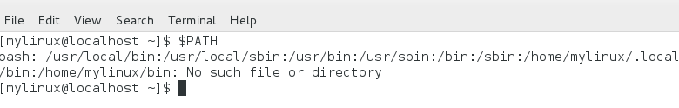

Environment Variables
PATH : This variable contains a colon(:)- separated list of directories in which your system looks for executable files. When you enter a command on terminal, the shell looks for the command in different directories mentioned in the $PATH variable, if the command is found, it executes. Otherwise, it return with an error.
HOME : Default path for user home directory
PWD : Prints current working directory

Slide 5

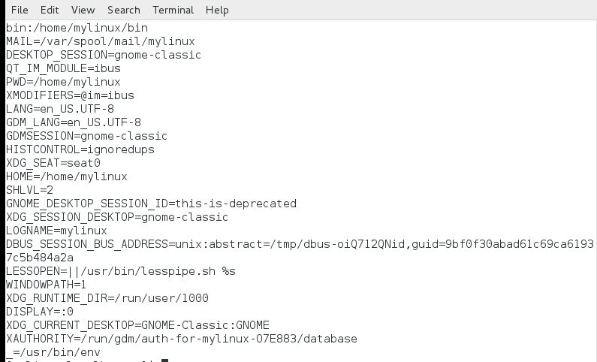
Environment Variables
SHELL :
UID :
Env : This command is used to display all environment variables

Slide 6
Process Management
Process : An instance of program is called process. Any Command we execute on Linux terminal creates a new process.
An Operation System can trace the process using the process id (pid)
Pid is unique for each process in the Operating System.
Types of Process :
Child Process : Process that is created by another Process ie Parent process during runtime is called child process. Each child process is created to do specific operation . A process can have many child Process but child can have only one parent process.
Daemon Process : A Daemon is a type of program on Unix-like operating systems that runs unobtrusively in the background, rather than under the direct control of a user, waiting to be activated by the occurrence of a specific event or condition

Slide 7
Zombie Process : A Zombie Process is a process that should be closed but still present in the process table due to parent process is busy in doing some other job . The process which is waiting in
the process table to get confirmation by the Parent process is called a Zombie Process.
Orphan Process : Orphan Process is a process whose parent process has finished or terminated but it still running itself. In Unix this process is adopted immediately by the INIT system process. Though it as parent but its original parent is terminated it is called Orphan Process.
Interactive Process : The process that interact instantly with user and therefore spending a lot of time for key passes and mouse operations.
Batch process : The process that frequently executed with minimum human interaction. Batch process jobs can run without any end-user interaction or can be scheduled to start up on their own as resources permit

Slide 8
Process Scheduling
Scheduling refers to the way the process are allocated to run on the available CPUs.
Functionality of Scheduler
CPU Utilization : The amount of time the cpu was in Use. Always make cpu as busy as possible.
Throughput : The number of process that completes the execution at a time is called throughput.
Turnaround Time : The time between the process enter the queue to complete its processing is called Turnaround Time.
Turnaround Time = Complete Time – Arrival Time
Wait Time : The amount of time the process is waiting in the ready Queue.
Waiting Time= Turnaround Time- Burst Time
Respond Time : The Amount of time that takes from when request is submitted to first response of the process.
Respond Time = Starting Time – Arrival Time
Fairness : Equal Cpu time to each Thread

Slide 9
Types of Scheduling :
Normal : It referred to as other, this is the scheduling type set for normal programs
FIFO : The term FIFO means First In First Out . The process which comes first is served first.
Round Robin : In this Scheduling time slice will be there so each process run that time slice period and wait until total process completes the execution of time .the Process continue until total processes complete the execution
SJF(shortest job first) : In this Scheduling , the process which has shortest burst time will execute first.
Priority Based Scheduling : In this Scheduling , the process which has highest priority execute first than the lowest priority Process

Slide 10
Inter Process Management
It is a set of techniques for the exchange of data among multiple in one or more processes.
Types of Inter Process Management :
Signals : sent by other processes or the kernel to a specific process to indicate the various conditions
Pipes : It special character “|” to route output of one program as input to other program
Socket : A socket is one end point to two way communication link between two programs running on the network
Message Queue : It is the mechanism that allows one or more process to write the message that can viewed by one or more process
Semaphore :A semaphore is a synchronization object that controls access by multiple processes to a common resource in a parallel programming environment. Semaphores are widely used to control access to files and shared memory. The three basic functionalities associated with semaphores are set, check and wait until it clears to set it again.
Shared Memory : The amount of mapping area is shared by multiple process.

